Slide 1
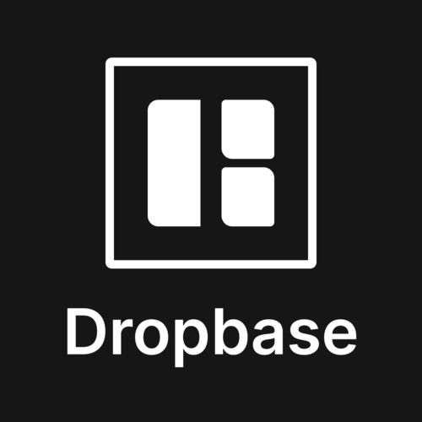
Dropcase: Broadening Horizons
Andy Liu Kevin Cui
Sat Arora Yang Li

Slide 2

Case Overview

Slide 3
Case Review
Dropbase is an up-and-coming software startup that allows consumers to upload data files and instantly convert them into live databases on the cloud
Currently operates on a hybrid pricing model which includes an up-front fee as well as a pay-by-usage fee
Most customers of Dropbase have between 10 and 100 employees and are ideally between Series A and Series C in financing
Willing to sacrifice short term profits for growth as it is better in the eyes of investors
Constraints
Snowflake pricing model makes computations shorter than 1 minute very cost inefficient
Requires elite software engineers that are already familiar with the company’s technologies (current employees include 4 full-time engineers, 2 contractors, and 3 co-op students)
Maturity, scalability, security, and performance of technologies used
Case Overview
Solution Overview
Logistical Analysis
Conclusion

Slide 4
Big Question and Problems
Dropbase is a company with an amazing product that should be in the hands of more people
Big question for this case: What can Dropbase adjust to its products, sales, and operations to maximize growth in the next 5 years
Immediate Issues: Developing a strategy to meet the target USD $10 mm ARR in 5 years
Underlying Issues:
Lost profit due to Snowflake pricing model
Small headcount (hard to find sufficiently skilled talent)
Niche consumer base

Slide 5
Decision Criteria
Mitigate the cost of Snowflake
Computes under 1 minute are rounded up and are a large sunk cost
Cost is variable based on compute time
Mitigating this cost would give much more profit to re-invest in the company
2. Achievable without hiring additional staff
Finding new employees that can integrate well is hard and time-consuming
This would cut into financial resources
3. Increase customer retention time
Decreases churn rate and increases RDM
Save financial resources on customer acquisition cost
Case Overview
Solution Overview
Logistical Analysis
Conclusion

Slide 6
Solution Overview

Slide 7
Solution Overview
Solution Overview: Broaden our consumer base to include more non-technical groups while retaining technical groups
1. Modification of the pricing model (appealing to a broader consumer base and mitigating sunk cost from snowflake)
2. Developing data analysis features (convenience and dependency)
3. Further development on the API (outreach to students and Hackathons)
Changes our solution would implement:

Slide 8
Proposed Pricing Model
Dropbase will stay with Snowflake
Faster performance than Oracle, and increased scalability, stability, and cost-efficient compared to other competitors in the space
Dropbase credit system will dissuade computations of less than 60 compute seconds
Computations over 60 seconds are recorded into a "compute bank"
After 1000 compute seconds are accumulated, a voucher will be awarded to the consumer.
Case Overview
Solution Overview
Logistical Analysis
Conclusion

Slide 9

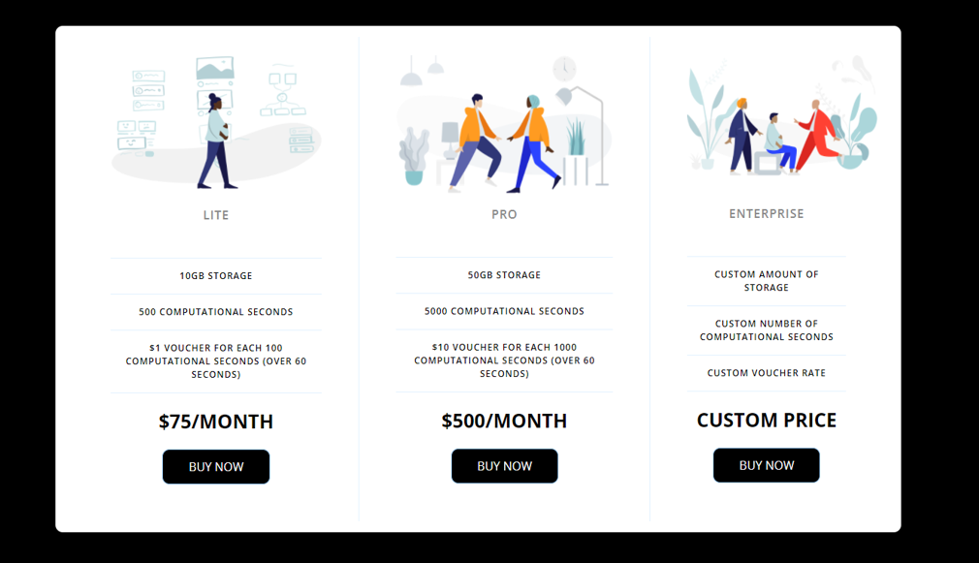
Proposed Pricing

Slide 10
Pricing Model – Impact
Mitigates the cost of snowflake
Reduces sunk cost of Snowflake's pricing model
Even though Dropbase will spend money, this pricing model and reward system encourages users to use Dropbase more often, which will offset the cost of awarding credits
Helps retain customers
Uniqueness of promotion is distinct from competitors. Nowhere else do users get discounted for using the product more.
Case Overview
Solution Overview
Logistical Analysis
Conclusion

Slide 11
Feature Additions – Data Analysis Tools and Data Templates
Data Analysis Tools
Built directly into Instant Databases and API
Decreases churn and increases customer life expectancy
With one button on Instant Database UI, create graphs
Percent Change Year-over-Year
Growth Projections
Employee Productivity Chart
Payroll Statistics Chart
Data Templates
Examples: Template excel files, templates integrated directly into Dropzone
Used for most common use cases of databases
Employee payroll lists
Banking and Accounting Data
Geared towards non-technical users
Makes data analysis tools easier to use
Case Overview
Solution Overview
Logistical Analysis
Conclusion

Slide 12
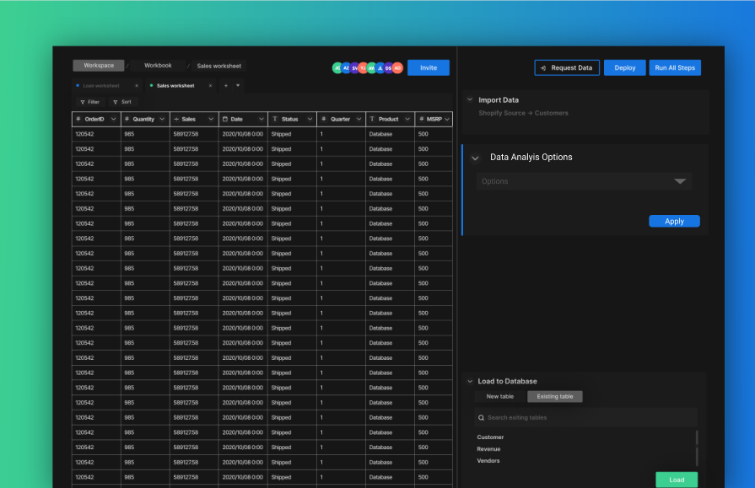

Slide 13
Feature Additions – Impact
Feasible without additional staff
Employees are already skilled in data processing, UI design
Retains customers
Purpose of features is to be more convenient and easier than alternative data analysis tools, as they are integrated directly into Instant Database
Appealing to non-technical users
Very easy to "press a button" to generate useful data, and to use a data storage template to manage
Ideally makes non-technical users "dependent" on Dropbase
These features are reasonable within 5 years
Case Overview
Solution Overview
Logistical Analysis
Conclusion

Slide 14
API Development
API is currently a prototype, but would be very useful for developer consumers, so it is important that this feature is available
Must include data analysis features
Can generate graphs and statistical interpretations of Data
Case Overview
Solution Overview
Logistical Analysis
Conclusion

Slide 15

API Development – Impact
Achievable without hiring additional staff
Retains customers
Development the API ensures that technical enterprises are able to customize their experience with Dropbase, and use our expanding lineup of features to match their own needs
Hackathons are also a cheap method of gaining potential customers for a low customer acquisition cost
Reaches more potential consumers by broadening our range of advertising
Hackathons
Demos
Education
Case Overview
Solution Overview
Logistical Analysis
Conclusion

Slide 16
Logistical Analysis

Slide 17
Financial Calculation of Price Model
Cost per 1 hour of Snowflake - $3.00
Cost per 1 minute of Snowflake - $0.05
Assuming perfect efficiency, for the Pro plan: 5000/60/60x3 = $4.17
Assuming perfect inefficiency, for the Pro plan: 5000x0.05 = $250.00
We will assume that the actual cost is about halfway: $127.09
Assuming the voucher bonus increases computes over 60 seconds by about another 50%, our actual cost becomes: $63.54 and we will give out about $37.50 in vouchers on average
This brings our total costs up to about $101.04
This general pattern holds for the "lite" pricing plan as well
This means we can offer customers a discount incentive to use more than 60 compute seconds which means they will get money back, but we will also save money in rounded up compute time expenses
Case Overview
Solution Overview
Logistical Analysis
Conclusion

Slide 18
Implementation – Short Term (3 months)
Allocate staff for different starting tasks
API Development: 3 Software Engineers, 1 Coop
Continue work with core Instant Database and Dropzone functionality
Data Analysis Algorithms: 2 Contractors, 1 Software Engineer
Requires research for most used charts and data analysis tools
Data Templates: 2 Coop
Announce to investors of future plans
LinkedIn, Devpost, Company reports

Slide 19
Implementation – Short Term (6 months)
Prototype of Data Templates completed, QA testing begins
Significant progress on API Core Instant Database and Dropzone functionality. QA Testing begins
Significant progress on Built-in Data Analysis tools
Since this is more difficult, development of these will take longer
Case Overview
Solution Overview
Logistical Analysis
Conclusion

Slide 20
Implementation – Medium Term (1 year)
Complete API Instant Database and Dropzone functionality
Begin Implementing Data Analysis functionality into API
Prototype of Built-in Data Analysis tools completed for Instant Database service
Begin QA testing
Complete Data Templates, hold off their release for later
Announce progress to potential future investors at the 1 year milestone
Case Overview
Solution Overview
Logistical Analysis
Conclusion

Slide 21
Implementation – Medium Term (2 Years)
Complete prototype of API, including new, built-in data analysis
Begin QA Testing
Finish development of Built-in Data Analysis tools
Announce Future Pricing Model in advance, allow current customers to adjust to change
Case Overview
Solution Overview
Logistical Analysis
Conclusion

Slide 22
Implementation – Long Term (3 – 5 Years)
Complete all development
Data Templates for ease of use to non-technical users
Built-in Data Analysis Tools into Instant Database Service, including UI
API functionality for Instant Database, Dropzone, and Data Analysis
Official Public Release
Release new pricing model, emphasize "Dropbase credit" system
Marketing at hackathons, tech conferences and company reports
Case Overview
Solution Overview
Logistical Analysis
Conclusion

Slide 23
Risks and contingency plans
Data Analysis tools underperform in the non-technical demographic
Offer version without them at a lower price to increase consumer life expectancy
Our work is not wasted! These tools can be part of a future "elite" version for the highly technical demographic.
Software development does not progress according to timeline
May need to hire more contractors and interns for simpler tasks, while our highly skilled software developers focus on core issues
Prioritize software in this order: Instant Database, Dropzone, API, Data Analysis tools, Data Templates
Snowflake cost mitigation strategies are not as effective as calculated
Temporarily increase costs to all price levels (lite, pro, enterprise)
Explore idea of "backlogging" multiple requests into one instance of compute seconds usage

Slide 24
Conclusion

Slide 25
Recap of our solution
Big question for this case: What can Dropbase adjust to its products, sales, and operations to maximize growth in the next 5 years
Overview: Broaden our consumer base to include more non-technical groups while retaining technical groups
Changes to pricing model
Further development on the API
Developing data analysis features

Slide 26
Why does our solution achieve the goal
Feasible and keeps with the company's core functions and products
Explores new consumer markets to expand the scope of reach and increase ADR in the long term
Able to be implemented given the company's current resources and situations
Tried to put ourselves in the shoes of the founders as if it were our risk and reward on the line

Slide 27
References
Proposed Pricing Model
https://ysjournal.com/oracle-vs-snowflake-traditional-to-modernised-database-technology/
https://qiuyujx.medium.com/what-makes-snowflake-different-from-other-dbms-as-a-cloud-based-software-3f21457cd78f
Snowflake Market Share
https://www.slintel.com/tech/data-warehousing/snowflake-market-share#faqs4
Figma Designs
https://www.figma.com/file/HmwMiV1sTESmlnmr2gbPu2/Data-Analysis-Instant-Database?node-id=0%3A1
Contingency Plan Research
https://www.targetprocess.com/guide/estimating-planning/backlog-organize-prioritize/requests-related-to-backlog-items/

Slide 28
Technical Demo

Slide 29
Proposed Pricing

Slide 30
Mock User Interface

Slide 31
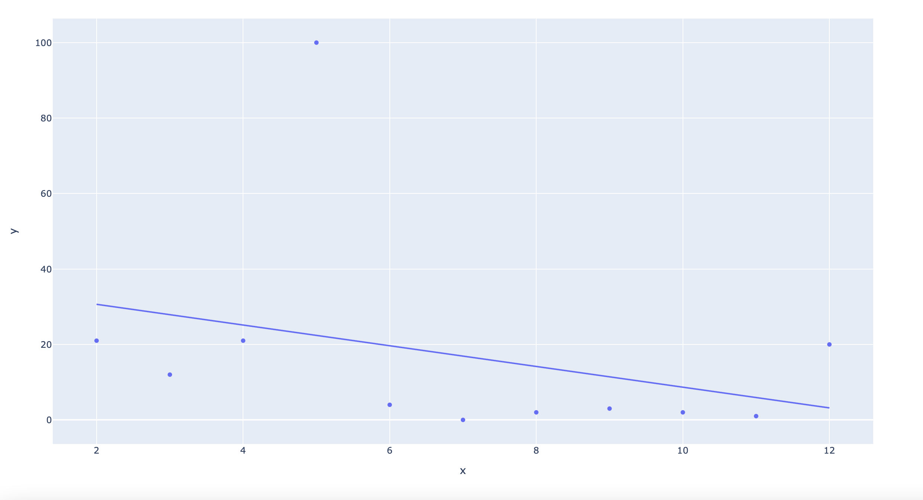
Mock Data Analysis

